Slide 1

Automotive SW Testing Life Cycle

Slide 2
Agenda
SW Testing Life Cycle (ASPICE V-Model)
Testing Life cycle & Tools Chains
Overall Test Goal and Strategies
Concept of Test Level
Test Role
2
Internal | RBVH/ENG32 Hoang Lan Huong | 8/8/2017
© Robert Bosch Engineering and Business Solutions Vietnam Company Limited 2017. All rights reserved, also regarding any disposal, exploitation, reproduction, editing, distribution, as well as in the event of applications for industrial property rights.

Slide 3
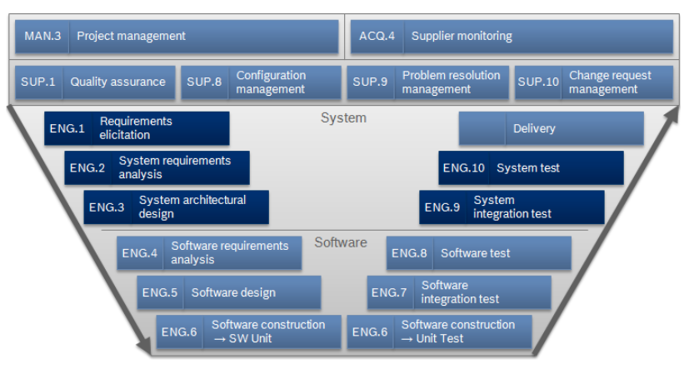
SW Testing Life Cycle (ASPICE V-Model)
Automotive Software Testing Life Cycle (V-Model)
3
Internal | RBVH/ENG32 Hoang Lan Huong | 8/8/2017
© Robert Bosch Engineering and Business Solutions Vietnam Company Limited 2017. All rights reserved, also regarding any disposal, exploitation, reproduction, editing, distribution, as well as in the event of applications for industrial property rights.

Slide 4
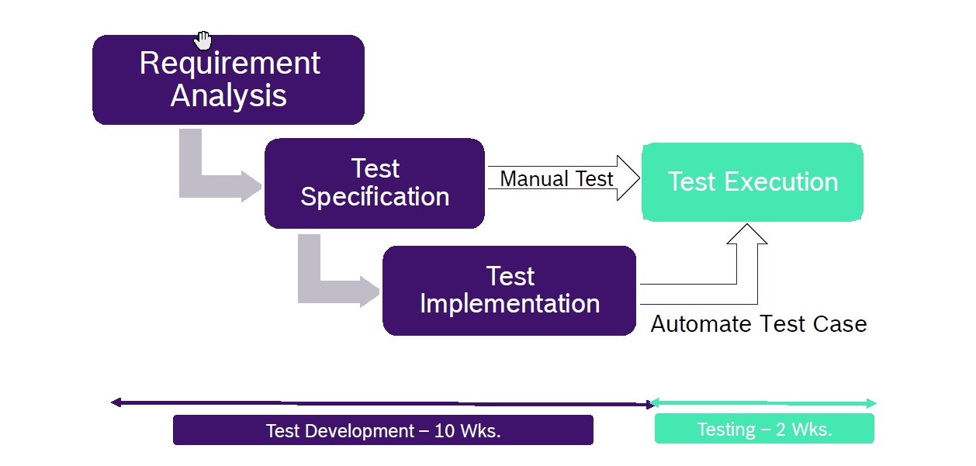
Testing Life Cycle - Engineering
Automotive Software Testing Life Cycle (V-Model)
Hardware Lab
DOORs
ClearCase
ClearQuest
Excel Sheet DOORs
RTRT, VCAR, TPT
HW Lab + Automation Tool
4
Internal | RBVH/ENG32 Hoang Lan Huong | 8/8/2017
© Robert Bosch Engineering and Business Solutions Vietnam Company Limited 2017. All rights reserved, also regarding any disposal, exploitation, reproduction, editing, distribution, as well as in the event of applications for industrial property rights.

Slide 5




Automotive Software Testing Life Cycle (V-Model)
Overall Test
Goals & Strategies
5
Internal | RBVH/ENG32 Hoang Lan Huong | 8/8/2017
© Robert Bosch Engineering and Business Solutions Vietnam Company Limited 2017. All rights reserved, also regarding any disposal, exploitation, reproduction, editing, distribution, as well as in the event of applications for industrial property rights.

Slide 6
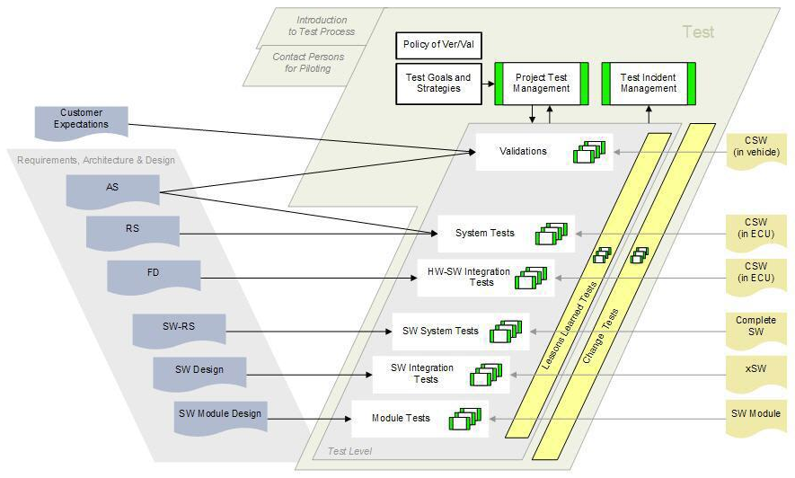
Test Goals & Strategies
Automotive Software Testing Life Cycle (V-Model)
Test Goals and
Strategies
Test Level
6
Internal | RBVH/ENG32 Hoang Lan Huong | 8/8/2017
© Robert Bosch Engineering and Business Solutions Vietnam Company Limited 2017. All rights reserved, also regarding any disposal, exploitation, reproduction, editing, distribution, as well as in the event of applications for industrial property rights.

Slide 7
Test Goals & Strategies - Test Levels
Automotive Software Testing Life Cycle (V-Model)
Test levels are defined by the input from the left side of the V-model.
Test Levels | Main input from left side of the V-Model | Content | Supporting input from left side
Validation | AS, RS | customer expectations
System Tests | RS, AS | system requirements | FD
HW-SW Integration Tests | Function Design | HW-SW interface specifications
SW System Tests | SWRS | software requirements | SW Design
SW Integration Tests | Software Design | SW interface specifications (changes)
Module Tests | SW Module Design | Code description | SWRS
For each Test Level are defined:
  Goals of Testing
  Strategy of Testing
  Entry and Exit Criteria
7
Internal | RBVH/ENG32 Hoang Lan Huong | 8/8/2017
© Robert Bosch Engineering and Business Solutions Vietnam Company Limited 2017. All rights reserved, also regarding any disposal, exploitation, reproduction, editing, distribution, as well as in the event of applications for industrial property rights.

Slide 8
Test Goals & Strategies - Systematic Testing
Automotive Software Testing Life Cycle (V-Model)
The number of possible test cases for a complex product like ESP is nearly infinite. To make efficient use of the restricted resources in a project (schedule, infrastructure, people) we test systematically and plan our major test activities.
Basis for our systematic approach is the introduction of test levels.
What is the Test Object?
The test object is always Software, the complete SW (CSW) or parts of it.
The test cases are developed to find software defects and not hardware defects.
8
Internal | RBVH/ENG32 Hoang Lan Huong | 8/8/2017
© Robert Bosch Engineering and Business Solutions Vietnam Company Limited 2017. All rights reserved, also regarding any disposal, exploitation, reproduction, editing, distribution, as well as in the event of applications for industrial property rights.

Slide 9
Test Goals & Strategies - Overall Test Strategy
Automotive Software Testing Life Cycle (V-Model)
Test the changes
  Test changed SW elements/functions (FNIDs) throughout the test levels
Perform regression tests for unchanged parts (at least one test on system level for each unchanged FNID)
Apply the test campaigns according to the purpose of the baseline
Automate test runs when appropriate
Use the appropriate test method and infrastructure (e.g. don’t do a module tests in a vehicle; static analysis vs. dynamic tests etc.), think of Simulation (dSpace)
Test sub-elements of the system before integration (“divide and conquer”: easier to locate the fault)
Enforce specifications, architectures and designs to improve the testability of the system
9
Internal | RBVH/ENG32 Hoang Lan Huong | 8/8/2017
© Robert Bosch Engineering and Business Solutions Vietnam Company Limited 2017. All rights reserved, also regarding any disposal, exploitation, reproduction, editing, distribution, as well as in the event of applications for industrial property rights.

Slide 10
Automotive Software Testing Life Cycle (V-Model)
Module Test
10
Internal | RBVH/ENG32 Hoang Lan Huong | 8/8/2017
© Robert Bosch Engineering and Business Solutions Vietnam Company Limited 2017. All rights reserved, also regarding any disposal, exploitation, reproduction, editing, distribution, as well as in the event of applications for industrial property rights.

Slide 11
Module Test
Automotive Software Testing Life Cycle (V-Model)
Definition of module:
“Module tests verify the smallest specified SW items. The test object of a module test is therefore essentially defined by the given SW architecture / design and not by the module test process.”
Test Targets are given:
  Platform: all changed and newly SW-module test items are module tested.
  Customer Projects: all changed and newly SW-module test items are module tested.
General: individual process descriptions for each xSW (ASW, HSW, DSW, …)
11
Internal | RBVH/ENG32 Hoang Lan Huong | 8/8/2017
© Robert Bosch Engineering and Business Solutions Vietnam Company Limited 2017. All rights reserved, also regarding any disposal, exploitation, reproduction, editing, distribution, as well as in the event of applications for industrial property rights.

Slide 12
Module Test
Automotive Software Testing Life Cycle (V-Model)
Baseline
planning
Unit test specification
SW
Module Design
Unit code coverage
Module
test
Test
result
SW unit
parameter
Test
Report
enumerations
The module test verifies
  that the implementation satisfies the software requirements and SW module design.
  that the implementation handles correctly the full value range at all interfaces of the
  SW-module test item.
  that the SW-module test item shows no unintended behaviour. This is proved by achievement of code coverage goals:
  - 100% statement coverage (C0)
  - 100% decision coverage (C1)
  - use Test Design Techniques (Equivalence partitioning, CTM, Boundary value analysis)
12
Internal | RBVH/ENG32 Hoang Lan Huong | 8/8/2017
© Robert Bosch Engineering and Business Solutions Vietnam Company Limited 2017. All rights reserved, also regarding any disposal, exploitation, reproduction, editing, distribution, as well as in the event of applications for industrial property rights.

Slide 13
Module Test
Automotive Software Testing Life Cycle (V-Model)
  Review: Reviews of test specifications should be done via “walk through”; Reviews of the Module test specification are optional.
  Analyze test records and results, create test report:
    For failed test cases due to SW bugs: lock the class in SW configuration management system and corrective actions have to be performed.
    Check if Code Coverage Goal (C0=100%, C1=100%) is reached; If the Code Coverage Goal is not reached, the not covered code needs to be analysed.
    If the gap is due to missing test cases, these need to be added to the test case specification.
    Create module test report e.g. using RTRT, TPT reporter.
13
Internal | RBVH/ENG32 Hoang Lan Huong | 8/8/2017
© Robert Bosch Engineering and Business Solutions Vietnam Company Limited 2017. All rights reserved, also regarding any disposal, exploitation, reproduction, editing, distribution, as well as in the event of applications for industrial property rights.

Slide 14
Automotive Software Testing Life Cycle (V-Model)
Integration Test
14
Internal | RBVH/ENG32 Hoang Lan Huong | 8/8/2017
© Robert Bosch Engineering and Business Solutions Vietnam Company Limited 2017. All rights reserved, also regarding any disposal, exploitation, reproduction, editing, distribution, as well as in the event of applications for industrial property rights.

Slide 15
SW Integration Test
Automotive Software Testing Life Cycle (V-Model)
BL
planning
Test cases
SW
Design
SW RS
Integration
test
Test incident report
SW
Arch.
FD
Interface
descrip-tion
Test
report
RS
xSW
verification of integration is done by testing the communication, interaction and functionality of components of a complex system in an aggregate grouping
verify that all SW-components (resp. Packages/Groups) are integrated
correctly into the SW (resp. xSW-Unit)
15
Internal | RBVH/ENG32 Hoang Lan Huong | 8/8/2017
© Robert Bosch Engineering and Business Solutions Vietnam Company Limited 2017. All rights reserved, also regarding any disposal, exploitation, reproduction, editing, distribution, as well as in the event of applications for industrial property rights.

Slide 16
SW Integration Test - ASPICE
Automotive Software Testing Life Cycle (V-Model)
SW Integration Test (ENG.7):
SW system correlates to SW architectural design
Interfaces between HW and SW work as specified, this means
  Inputs to the ECU reach the relevant SW functions in the expected format
  Inputs to the microcontroller which have their origin inside the ECU reach the relevant SW function in the expected format
  Outputs of SW functions lead to the expected change of a ECU output
  Outputs of SW functions lead to the expected change of a µC output or change on the signal destination inside the PCB.
Interfaces between SW modules work as specified, this means
  The SW system works as specified.
  Interfaces to 3rd party application modules are working as specified.
Threshold values and debounce times for HW diagnosis, this means
  Does the debounce time start after a measured value is above/below a threshold value
  Is the debouncing interrupted, if a measured value is within it’s borders
  Is the correct error flag raised or cleared after the debouncing is completed
16
Internal | RBVH/ENG32 Hoang Lan Huong | 8/8/2017
© Robert Bosch Engineering and Business Solutions Vietnam Company Limited 2017. All rights reserved, also regarding any disposal, exploitation, reproduction, editing, distribution, as well as in the event of applications for industrial property rights.

Slide 17
Automotive Software Testing Life Cycle (V-Model)
System Test
17
Internal | RBVH/ENG32 Hoang Lan Huong | 8/8/2017
© Robert Bosch Engineering and Business Solutions Vietnam Company Limited 2017. All rights reserved, also regarding any disposal, exploitation, reproduction, editing, distribution, as well as in the event of applications for industrial property rights.

Slide 18
System Test
Automotive Software Testing Life Cycle (V-Model)
SW Test(ENG.8):
The purpose of the SW Validation process is to validate that the integrated SW meets the defined SW requirements and to release the SW with controlled and documented quality.
Tools:
Inputs:
SW Requirements including verification criteria
Outputs:
SW Validation test cases referenced to SW Requirements
SW Release Test Plan
SW Validation test case review report
SW Validation test records
Released SW with SW Release Note
18
Internal | RBVH/ENG32 Hoang Lan Huong | 8/8/2017
© Robert Bosch Engineering and Business Solutions Vietnam Company Limited 2017. All rights reserved, also regarding any disposal, exploitation, reproduction, editing, distribution, as well as in the event of applications for industrial property rights.

Slide 19
System Test
Automotive Software Testing Life Cycle (V-Model)
System Integration Test (ENG.9):
The purpose of the System Integration Test process is to integrate all system elements and verify that all system elements interoperate as defined by system architecture.
Tools:
Inputs:
SW/ME/EE component releases delivered to System Integration according to sample definition sheet.
System Architecture including verification criteria
Outputs:
System Integration Strategy
System Integration Test cases referenced to system architecture
System Integration Test case review record
System Release Test Plan
System Integration test records
Integrated system ready for System Validation
Bi-directional traceability between System Architecture and System Integration test cases
19
Internal | RBVH/ENG32 Hoang Lan Huong | 8/8/2017
© Robert Bosch Engineering and Business Solutions Vietnam Company Limited 2017. All rights reserved, also regarding any disposal, exploitation, reproduction, editing, distribution, as well as in the event of applications for industrial property rights.

Slide 20
System Test
Automotive Software Testing Life Cycle (V-Model)
System Validation(ENG.10):
The purpose of the System Validation process is to validate that the integrated system meets the defined system requirements and to release the system with controlled and documented quality.
Tools: dSPACE HiL, I/O Box
Inputs:
System requirements including verification criteria.
Outputs:
System Validation test cases referenced to system requirements
System Validation test case review report
System Release Test Plan
System Validation test records
Released system with System Release Note for platform projects
Released system with Customer Delivery Letter for customer projects
20
Internal | RBVH/ENG32 Hoang Lan Huong | 8/8/2017
© Robert Bosch Engineering and Business Solutions Vietnam Company Limited 2017. All rights reserved, also regarding any disposal, exploitation, reproduction, editing, distribution, as well as in the event of applications for industrial property rights.

Slide 21
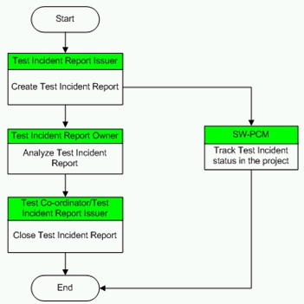
Test Incident Report
Automotive Software Testing Life Cycle (V-Model)
renaming of Defect to Test Incident
Report
not allowed to set to invalid
instead forward it to some other
responsible
21
Internal | RBVH/ENG32 Hoang Lan Huong | 8/8/2017
© Robert Bosch Engineering and Business Solutions Vietnam Company Limited 2017. All rights reserved, also regarding any disposal, exploitation, reproduction, editing, distribution, as well as in the event of applications for industrial property rights.

